Slide 1
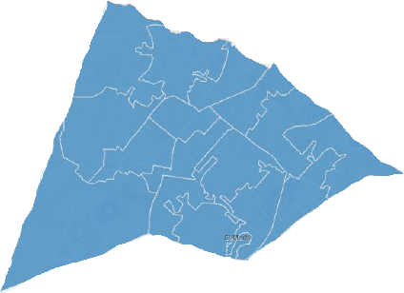
Cheltenham Integrated Locality Partnership
Chair Helen Goodey
How We Work Together
Innovation in Cheltenham
We reviewed population health data to better understand communities in Cheltenham Locality and developed innovative approaches to our collective priorities:.
Our Partners Include
To proactively tackle the root cause of health inequalities and improve health and wellbeing in Cheltenham. We want to empower people in Cheltenham to improve their health and wellbeing.
West CheltenhamCommunity
St Paul’s Respiratory
Pilot
Central CYP mental
health
Peripheral Frailty
Project
Community driven
Innovative Format
Proactive
Innovation Labs
West Cheltenham Health Equality
Focus area: Cheltenham has a close to county average life expectancy, but shows significant inequality in life expectancy between the most and least deprived residents. This translates to 10 years difference in life expectancy. This difference is most acutely seen in West Cheltenham.
Emerging priorities in West Cheltenham:
Access to transport
Opportunities for young People
Access to healthcare and dental care
Hester’s Way, Springbank, St Peters and St Marks
Next steps:
Taking time to find the right answers
Continued community engagement
Plans for youth group and luncheon group
Potential for employment of a
community support worker
West Cheltenham Key Actions-
Workshop collaboration
20 regular project meeting attendees
Representation from community,
social care, health. Housing, council etc
Community engagement in Springbank produced 70+ responses

