Slide 1
WEST CHELTENHAM PARTNERSHIP
AGM and Partnership Meeting
13th November 2023

Slide 2
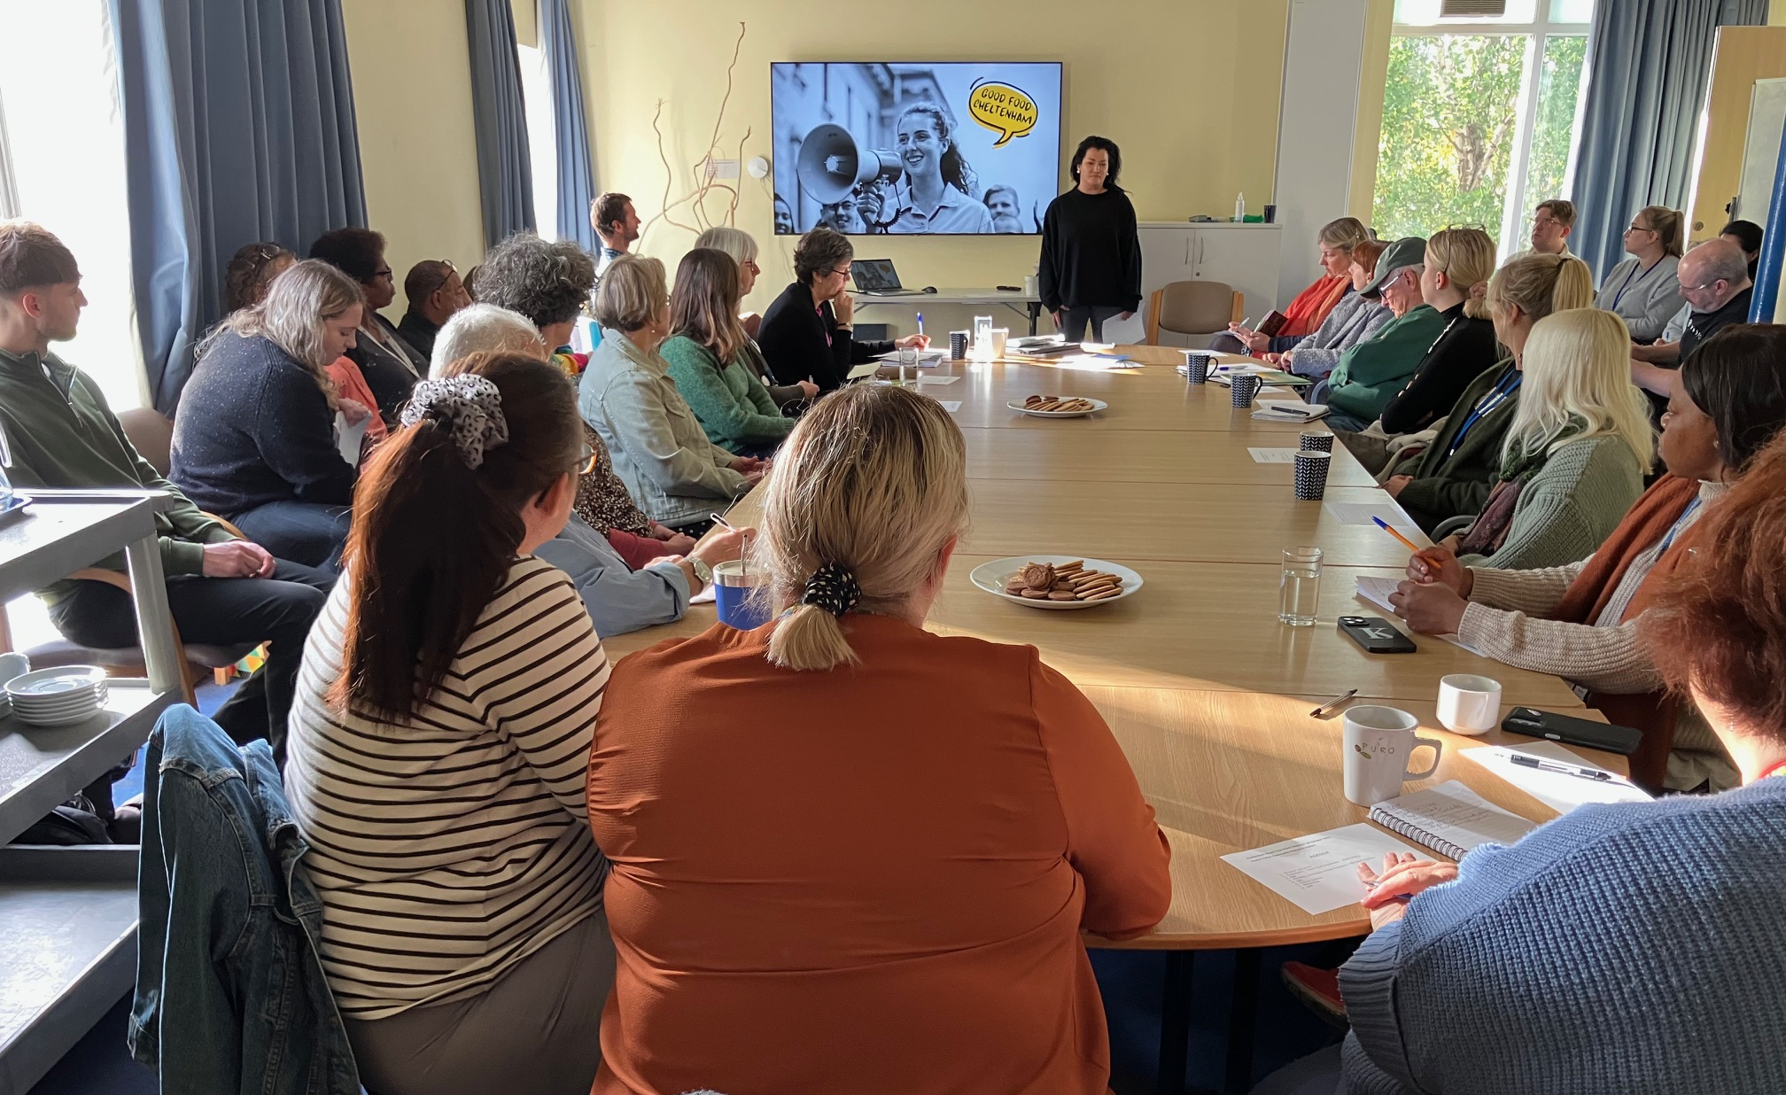
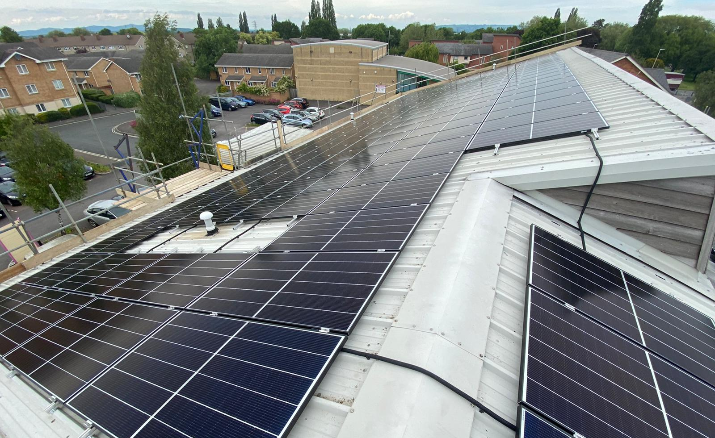
THANKS
It wasn’t just the covid pandemic that caused the WCP another troublesome year...
We would like to thank the following for their contributions and commitment to the Partnership this year
STAFF & VOLUNTEERs
Jacquie Boyer plus Rachel Clifford and Kelly Mitchell, for all their hard work at the Dreamscheme and Ami Walker for her superb work managing the Community Pantry and a special mention to Noel Conway, Ana Ornelas and Jake Richmond for their unstinting support! Not to mention Adrian Thompson who’s been excellent in his facilities management role - thanks to all!!
DIRECTORS
Board of Directors for their commitment, support and guidance throughout the year and particularly to new members Simon and Michael, assuming they’re signed up today!
EVERYONE ELSE ☺
The individuals, residents, volunteers, officers and organisations who attend meetings and commit time and energy to all our partnership projects.

Slide 3
FUNDING AND SUPPORT
FUNDING
Cheltenham Borough Council (Community Resilience Fund – Community Pantry–Community Infrastructure Levy)
Gloucestershire County Council (Levelling Up fund)
Enovert (Springbank Creative Space)
Feed Cheltenham and Cheltenham Lions Club (Community Pantry)
Additional funding was raised for Midsummer Fiesta from 3 GCC councillors; Williams Harman and Willingnam
Public financial support totals £5,000 since opening and food donations from St Thomas More, Leckhampton, and St Barnabas Churches plus Pates and St Marks schools have helped stock the pantry.
Our thanks go to all!
SUPPORT
Thanks go out to all partners for their support and cooperation.
GRCC and Feed in Tariff
Bromford, Pates, All Saints Academy, West Cheltenham Parish, DS Legal, CBC and GCHQ for their invaluable in-kind contributions

Slide 4
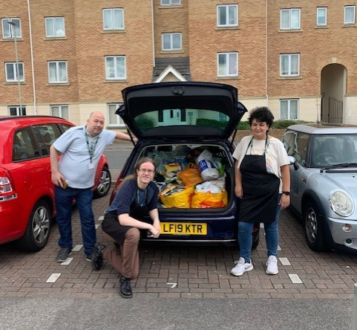
COMMUNITY PANTRY
The West Cheltenham Pantry Project was conceived back in 2018 as an opportunity to support the community by offering donated food to people in need.
It was agreed that the relationships which would develop with residents around food could allow further advice and guidance to try to help those people with other life issues they may be facing.
Members can choose from fresh meat, dairy, fruit and vegetables, to the value of approximately £20, for £4.00 a week.
The Pantry is now open on Wednesdays and Thursdays and has served over 300 individuals and families over the year
Grant support has been received from to CBC Health and Wellbeing funds, GCC Levelling Up funding and NHS. Further funds supplied by #FeedCheltenham and The Lions Club
Public financial support totals £5,000 since opening and food donations from St Thomas More, Leckhampton, and St Barnabas Churches plus Pates and St Marks schools have helped stock the pantry. Our thanks go to all!

Slide 5
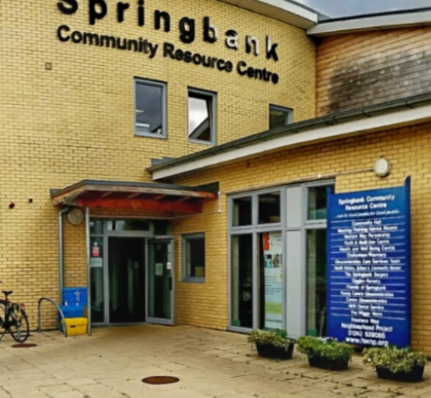
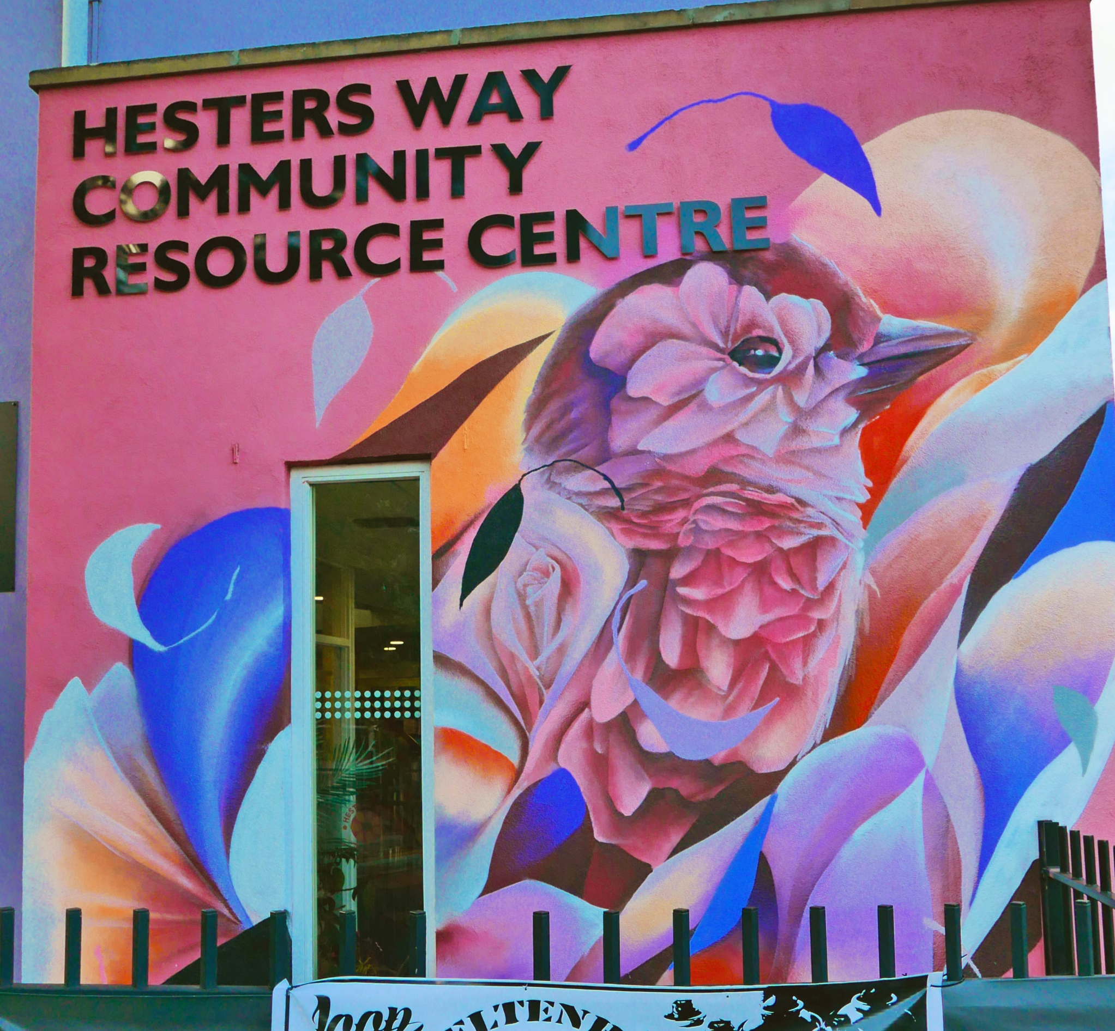
COMMUNITY CENTRES
HESTERS WAY AND SPRINGBANK
FACILITIES MANAGEMENT
Since taking over management of the Community Centres we have invested in a variety of upgrades and improvements including LED lighting, SCRC boiler replacement and reduced and curbed costs.
TENANTS
Tenants provide services to the local community including;
West Cheltenham Surgery and Dentists Cheltenham Borough Homes, Desirable Childcare, The Cheltenham Pharmacy, Glos NHS Health and Care / District Nurses, Brighter Homecare, Chinese Childrens and Parents Association, Listening Post, Head to Toe Health, Dial-a-Cab, Andrew Bird Hearing

Slide 6
ENVIRONMENT / RENEWABLES
PROJECTS
Hesters Way Solar Panels
Solar project 1 - 153,oookW generated to date – the equivalent of planting 1800 trees
Springfield Park Green Flag for the 13th year announced in October
Fiddlers Green Park Tree Planting
Hesters Way Forum facilitated by WCP have raised funds from CIL and Enovert to improve the play area.A total of £30k is now available for the project in 2024
LED Lighting project saw the installation of 200 new lights across the two community centres with Target 2030 funding support

Slide 7
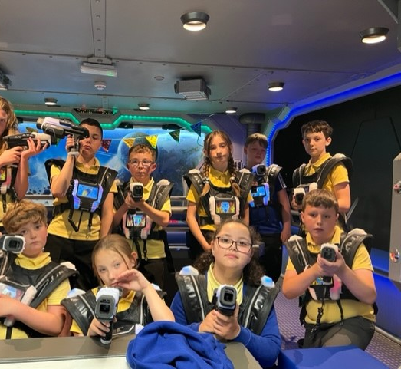
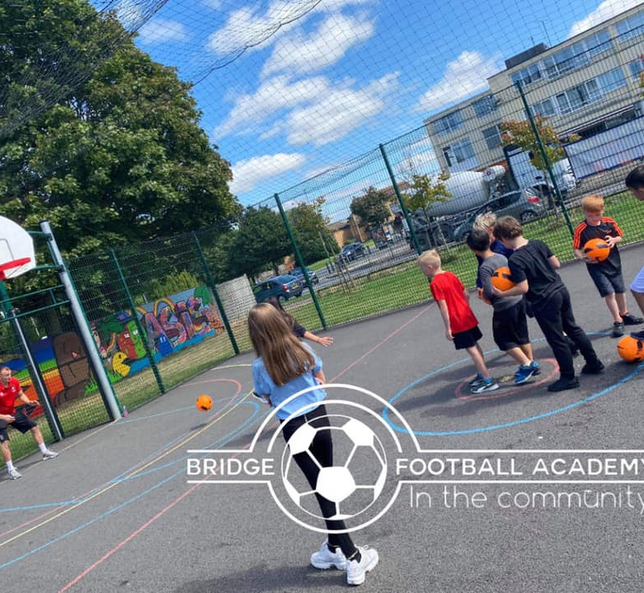
CHILDREN AND YOUNG PEOPLE
PROJECTS
Sports coaching at the MUGA, Oasis during spring, autumn holidays plus in the summer with HAF funding.
Dreamscheme – Continued for its 12th year with Hesters Way Primary School. Kelly Mitchell joined the team this last September and has enjoyed a great first year with the project
The Children and Young People's network continues to operate with members from a variety of organisations working collaboratively and supplying activities locally.
Special mention to Springbank Community Group who have supported youth outreach work in Springbank funded by the partnership in 2023.
Exciting development of the Springbank Creative Space at SCRC. We’ve raised funds from CIL and Enovert to develop the foyer into a new space for local creativity
Funds are being sought to kick off the space for youth in the new year

Slide 8
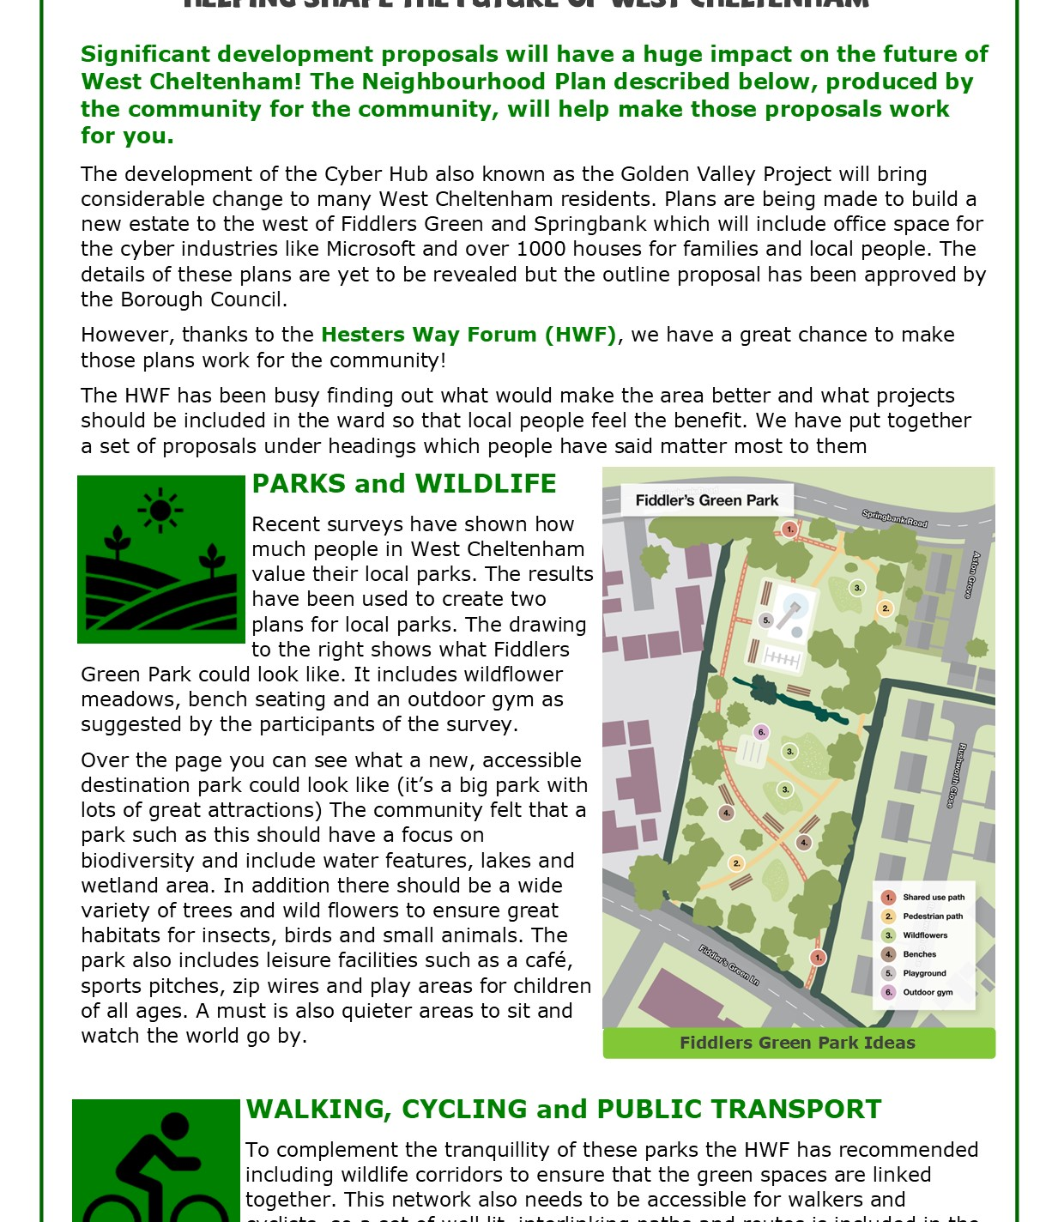
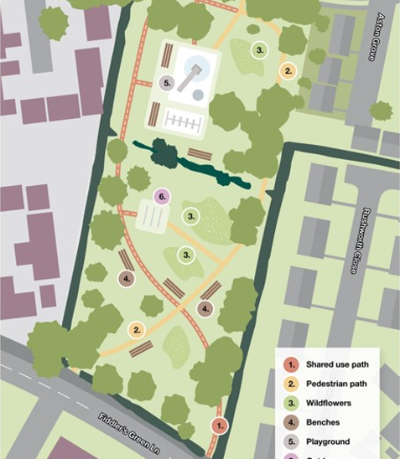
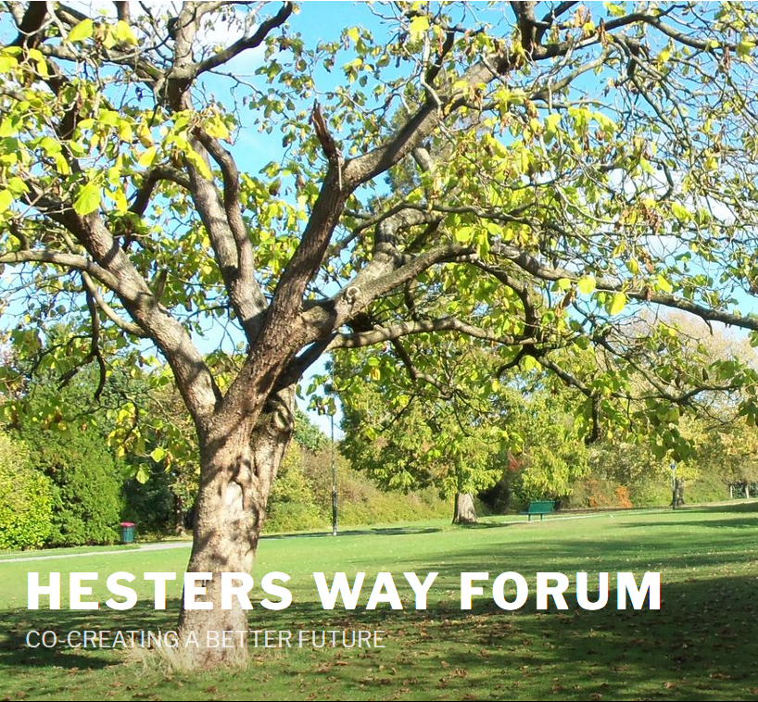
NEIGHBOURHOOD DEVELOPMENT PLAN
The Hesters Way Forum has formulated visions and aspirations for the future and is finalising policy statements. Ideas include;
The Hesters Way Forum has led community discussions with Golden Vally developers to ensure the best outcomes for the people of West Cheltenham
Green environment improvements
Cyber Hub landscaping plan
Traffic, roads, pavements and parking solutions
Walking cycling and public transport for all
Housing / community development sites
Local economic and employment opportunities
For details see the website
www.hesterswayforum.co.uk

Slide 9
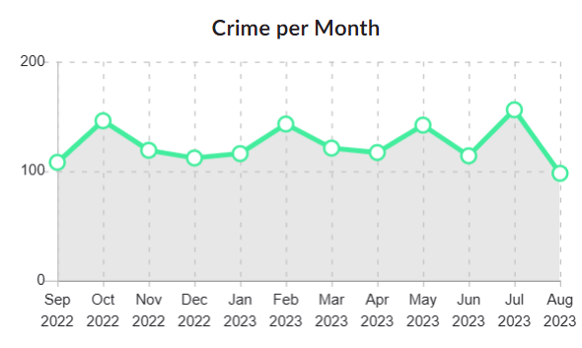
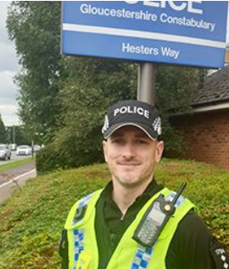
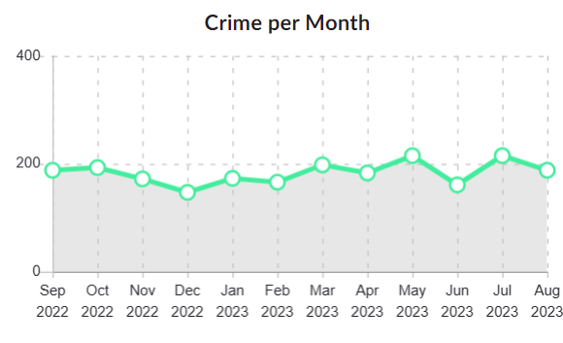
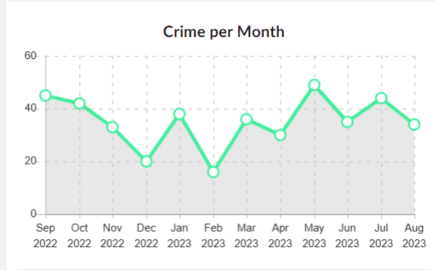
NEIGHBOURHOOD COORDINATION GROUP
Hesters Way crimes / month
CRIME RATES
St Marks has the highest rates followed by Hesters Way and Springbank. The levels are generally steady, but ASB and violent / sexual offences continue to dominate
PRIORITIES
HW - Patrol Scott and Edward Wilson House, to reduce Anti-Social Behaviour , linking in with Cheltenham Borough Homes and other partner agencies
St M - Disruption of drug dealing and protecting vulnerable residents in the Monkscroft area. Working with our partner agencies .
St Marks crimes / month
Springbank crimes / month

Slide 10
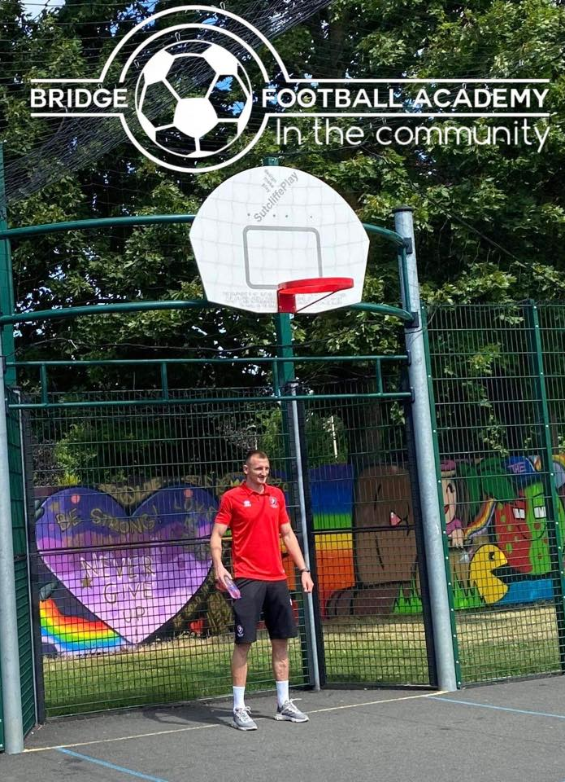
COMMUNITY ACTIVITIES
Easter Eggstravaganza – Cancelled again!
community event usually attracting 350 residents and 15 local organisations
Community Meetings
Neighbourhood Coordination 3 meetings per year
Children and Young People 3 meetings per year
Neighbourhood Development Plan
45 meetings this year
All held on Zoom!

Slide 11
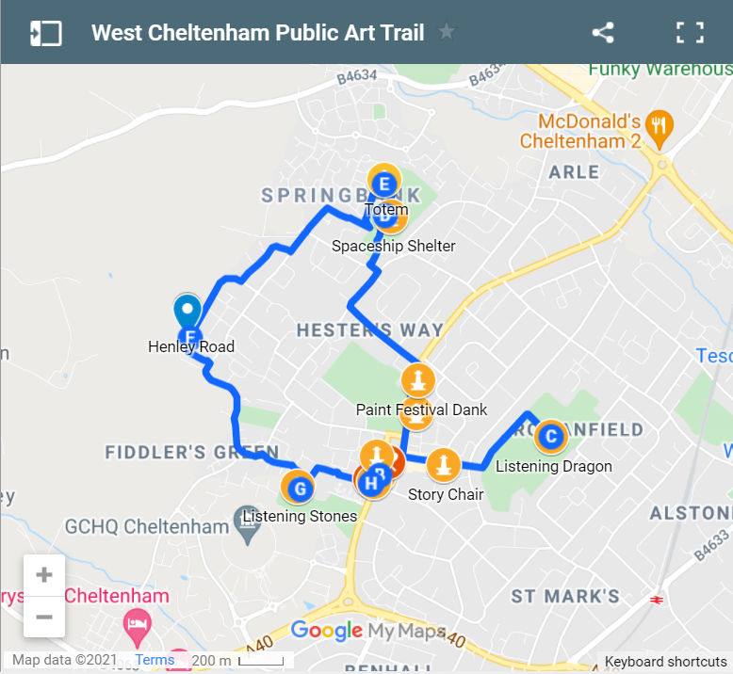
OTHER ACTIVITIES
Midsummer Fiesta – Cancelled in 2023
Cheltenham Communities Partnership
Cheltenham Culture Board –
Cheltenham Sports Strategy
NHS Wellbeing Project
VCS Forum

Slide 12
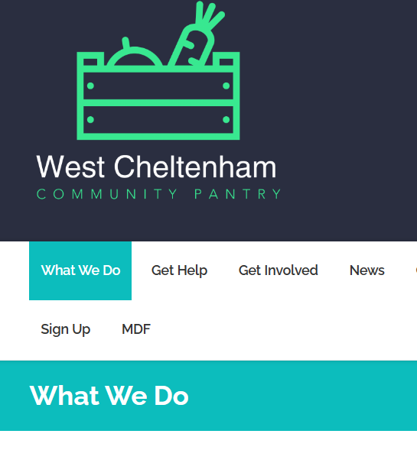
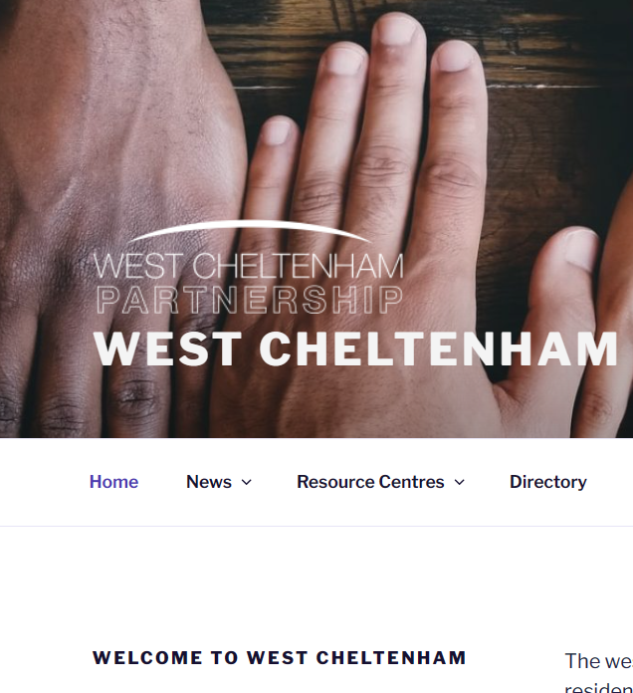
COMMUNICATION
VIEWPOINT
Local news, stories, events and photos. Copies distributed locally.
DIRECTORY
List and map of activities, groups and organisations.
WEBSITE
Resource for meeting minutes, links and background information.
TWITTER
currently have 866+ followers.
FACEBOOK
Currently we have 661+ likes 736 follows

Slide 13
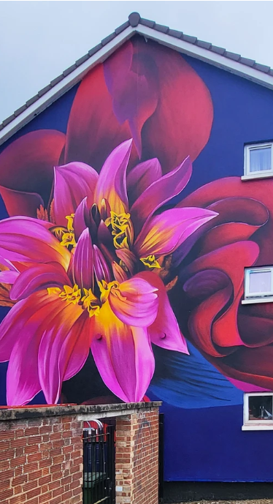
COMING SOON
Community Café
Springbank Creative Space
Volunteering opportunities
Training and Education
Sports Coaching Project – Easter 2024
13th Green Flag Award (Springbank)
Hesters Way Neighbourhood Plan – Coming in 2024
Thanks for listening and here’s to a great 2024!

